Slide 1
Virtual Threads in Java 19
Georgi Yolovski

Slide 2
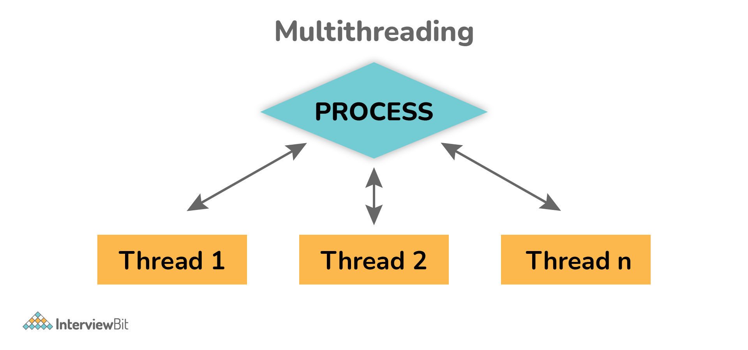
What is a thread
An independent set of instructions
Used for executing tasks in parallel
Managed by a scheduler

Slide 3
The problem with threads
Take too much memory (> 1MB)
Slow creation time
Slow context switching

Slide 4
Virtual threads
a.k.a “green threads”, user-mode threads, tasks, routines, etc.
Introduced in Java 19 (as a preview feature)
One OS thread can have many virtual threads
Smaller size (starts from 200-300 bytes)
Cheap start/stop
Fast context switching

Slide 5

DEMO
Virtual Threads

Slide 6
DEMO
Fly.io

